Slide 1


OECD Mean, OECD Average and Computation of Standard Errors on Differences
Guide to the PISA Data Analysis Manual
Notes:
J’ai recentré le cadre et joué avec la largeur pour une mise en page qui me semblait meilleure

Slide 2
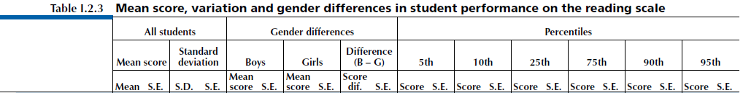
OECD Average, OECD Total
PISA is reporting the OECD Total and the OECD average

Slide 3
OECD Average, OECD Total
The OECD total takes the OECD countries as a single entity, to which each country contributes in proportion to the number of 15-year-olds enrolled in its schools. It illustrates how a country compares with the OECD area as a whole.
The OECD average:
In PISA 2000, 2003 & 2006, takes the OECD countries as a single entity, to which each country contributes with equal weight. For statistics such as percentages or mean scores, the OECD average corresponds to the arithmetic mean of the respective country statistics.
In PISA 2009, corresponds to the arithmetic mean of the respective country estimates
Notes:
Au dernier point: est-ce aussi pour les pays de L’OCDE seulement

Slide 4
OECD Average, OECD Total
How to compute the OECD Total:
Solution 1:
Create a file with OECD countries only;
Set for instance a alphanumerical variable country=“TOTAL”;
Replicate exactly the same analyses on this new data set, without breaking down the analyses by CNT.
Solution 2
Merge the two data sets and implement the analyses only once.

Slide 5
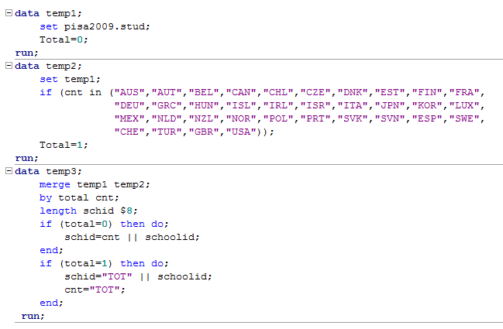
OECD Average, OECD Total
SAS syntax for data with OECD Total

Slide 6
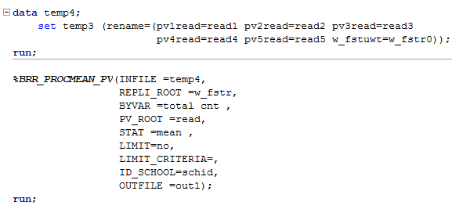
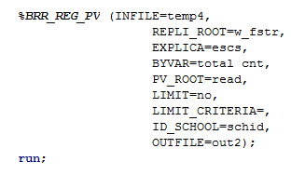
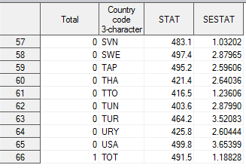

OECD Average, OECD Total

Slide 7
OECD Average, OECD Total
How to compute the OECD Average in PISA 2000, 2003 and 2006
Solution 1:
Create a file with OECD countries only;
Set for instance a alphanumerical variable country=“Average”;
Transform the final weight and replicates;
Replicate exactly the same analyses on this new data set, without breaking down the analyses by CNT.
Solution 2
Merge the two data sets

Slide 8
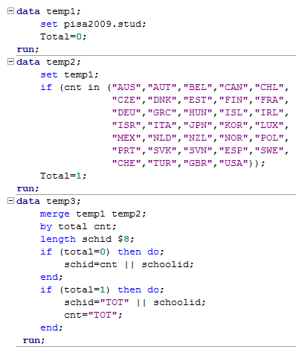
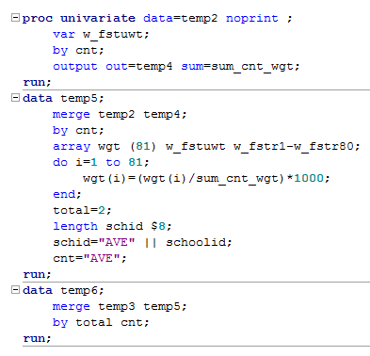
OECD Average, OECD Total
SAS syntax for data with OECD Total & Average (2000, 2003 & 2006)

Slide 9
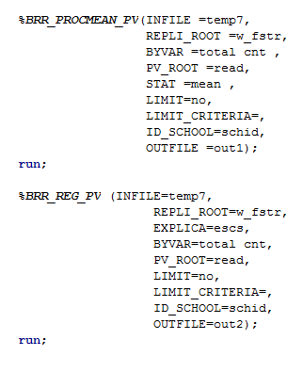
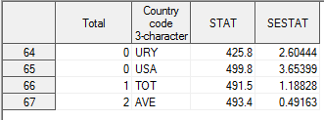
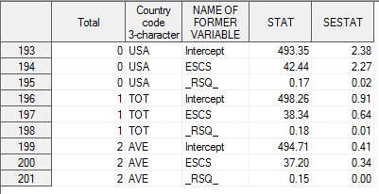
OECD Average, OECD Total

Slide 10
OECD Average, OECD Total
How to compute the OECD Average in 2009:
Let or any other statistic estimates
Mathematically, the OECD average is equal to:
Statistical indicators | PISA 2000 procedure: Replicates on the pool data set | PISA 2009 procedure: Arithmetic mean
Mean | 493.4 (0.49) | 493.4 (?)
Regression Intercept | 494.7 (0.41) | 493.9 (?)
Regression ESCS coefficient | 37.2 (0.34) | 38.3 (?)
Regression R² | 0.15 (0.00) | 0.14 (?)

Slide 11
OECD Average, OECD Total
How to compute the SE on the OECD average?

Slide 12
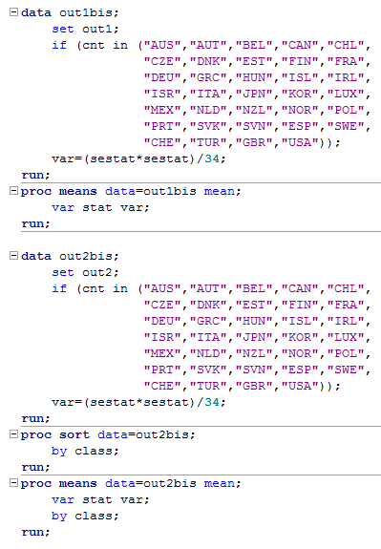
OECD Average, OECD Total
Statistical indicators | PISA 2000 | PISA 2009
Mean | 493.4 (0.49) | 493.4 (0.24)
Regression Intercept | 494.7 (0.41) | 493.9 (0.11)
Regression ESCS coefficient | 37.2 (0.34) | 38.3 (0.17)
Regression R² | 0.15 (0.00) | 0.14 (0.00)

Slide 13
Standard Errors on Differences
How to compute the standard error of the difference between :
Two countries;
An OECD country and the OECD total or the OECD average
A partner country and the OECD total or the OECD average
Two groups of students (e.g. boys versus girls, natives versus non natives) within countries?

Slide 14
Standard Errors on Differences
School ID | School mean | Boys mean | Girls mean
01 | 400 | 350 | 450
02 | 450 | 410 | 490
03 | 500 | 470 | 530
04 | 550 | 530 | 570
05 | 600 | 590 | 610
Mean | 500 | 470 | 530
06 | 500 | 470 | 530
Mean if 01 replaced by 06 | 520 | 494 | 546
Mean if 05 replaced by 06 | 480 | 446 | 514

Slide 15
Standard Errors on Differences
The expected value of the covariance between the two estimates:
should be equal to 0 if the two samples are independent, i.e.
Two countries
A partner country and the OECD Total or OECD Average
Two explicit strata within a country
should be different from 0 if the two samples are not independent
Two groups within a country if the group variable was not used as explicit stratification variable
An OECD country and the OECD Total or OECD Average

Slide 16
Standard Errors on Differences
How important is this covariance?
Country correlation between school performance for boys and school performance for girls, and country intraclass correlation

Slide 17
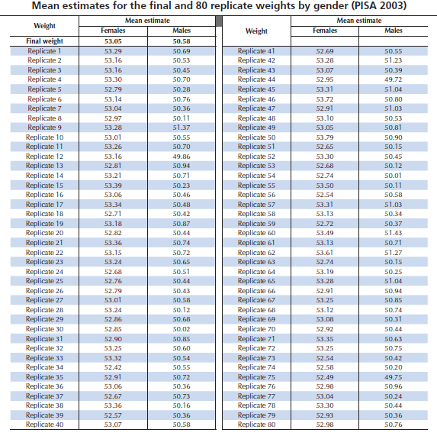
Standard Errors on Differences

Slide 18
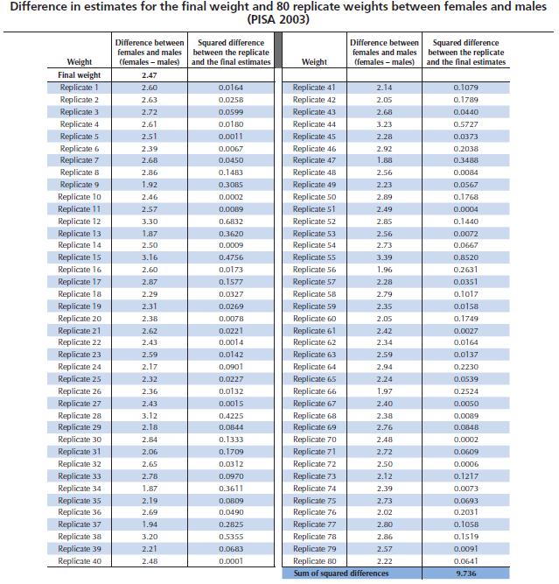
Standard Errors on Differences

Slide 19
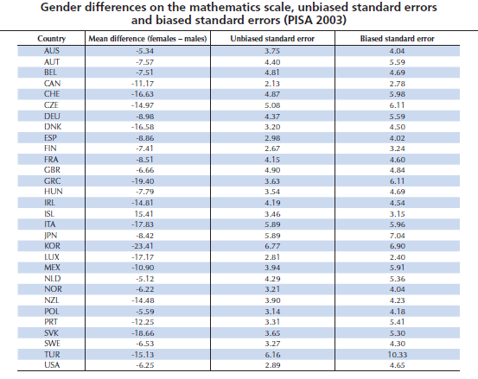
Standard Errors on Differences

Slide 20
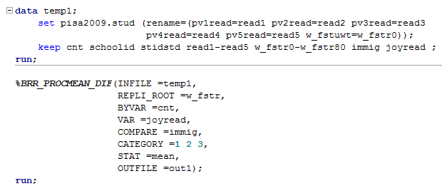
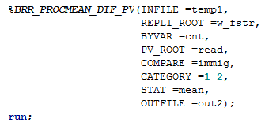
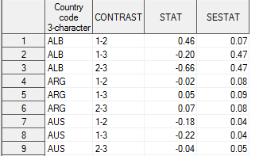
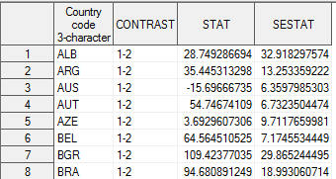
Standard Errors on Differences

Slide 21
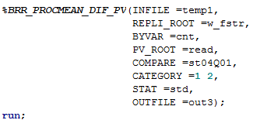
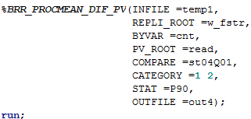
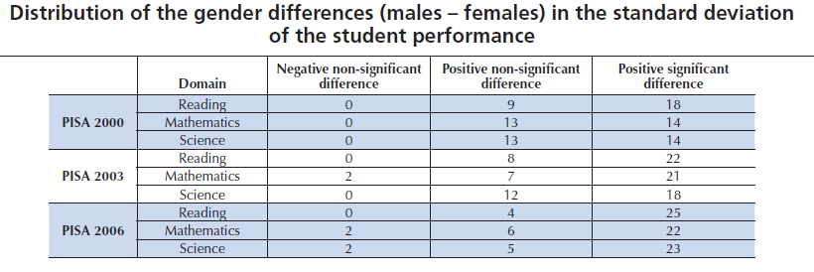
Standard Errors on Differences
These two macros can also be used to compute the SE on the difference for STD, Variance, percentiles, quartiles…

Slide 22
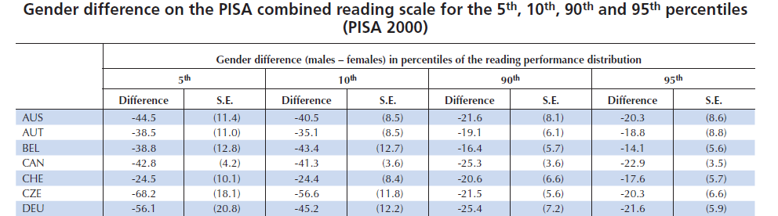
Standard Errors on Differences
On average, gender differences in mathematics are small but substantial differences can be observed between male and female high achievers

Slide 23
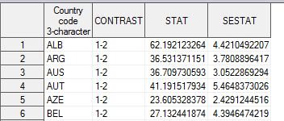
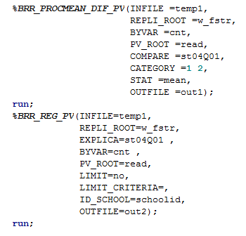
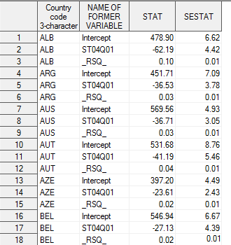
Standard Errors on Differences

Slide 24
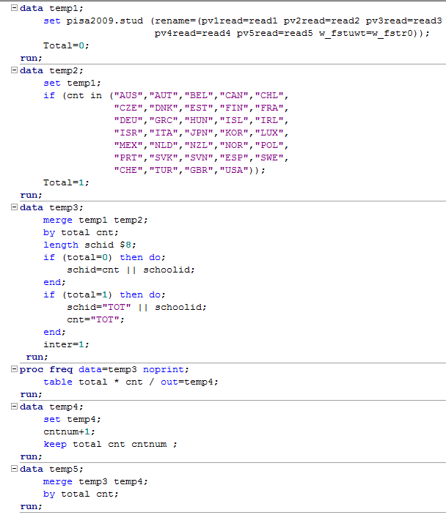
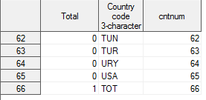
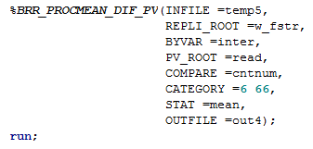

Standard Errors on Differences
SE between the OECD total and an OECD country.

Slide 25
Standard Errors on Differences
SE between the OECD average and an OECD country:
PISA 2000, 2003 and 2006
Same procedure as for the comparison between an OECD country and the OECD Total, except that the final weight and the replicates have to be transformed
PISA 2009

Slide 26
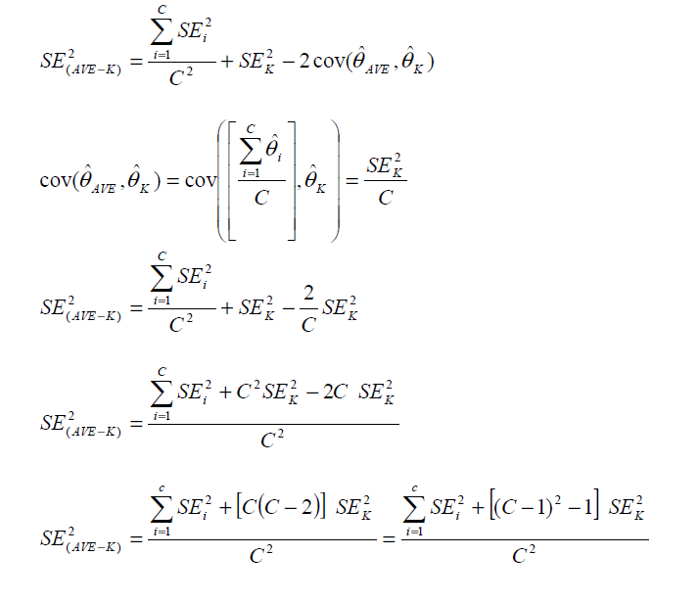
Standard Errors on Differences

Slide 27
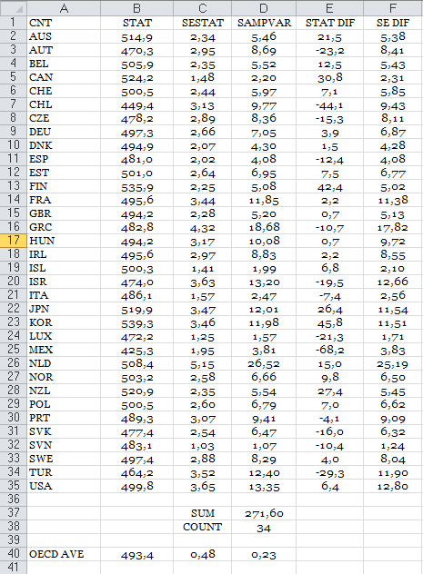
Standard Errors on Differences
=($D$37+(((($D$38-1)*($D$38-1))-1)*D2))/($D$38*$D$38)
=SUM(D2:D35)
=COUNTIF(D2:D35,">0")
=D37/(D38*D38)

Slide 28
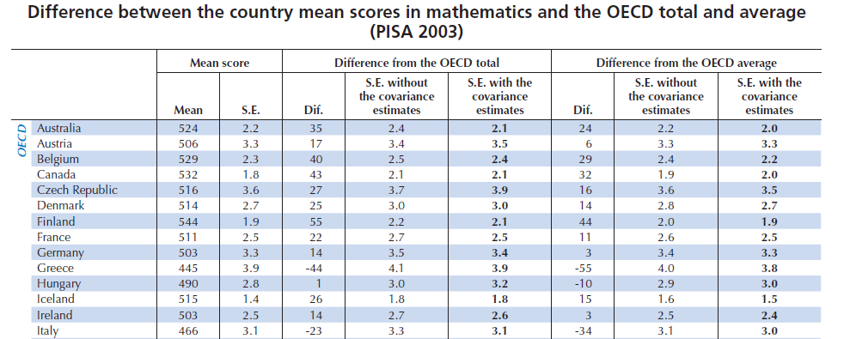
Standard Errors on Differences

Slide 29
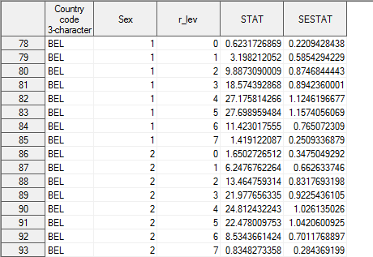
Computation of SE with PVs
Proficiency levels

Slide 30
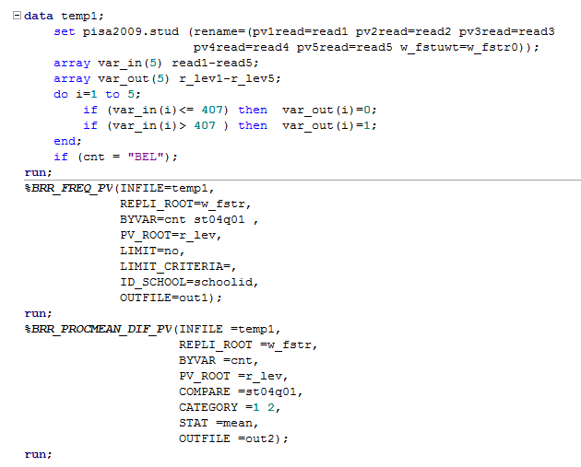
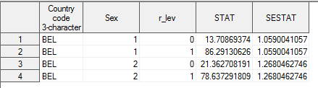

Computation of SE with PVs

